Slide 1

Challenges in the Therapy Sector

Slide 2

Title: "TheraBalms MVP: Your Path to Mental Wellness”
Subtitle: “Addressing Challenges in the Therapy Sector"

Slide 3

Introduction
Welcome to the introduction of TheraBalms, an innovative initiative intended to change the way mental health care is provided. We acknowledge the significant challenges the therapy industry is facing in a world where mental health is becoming more and more important.
By ensuring that mental health care is available, stigma-free, and catered to a variety of needs, we take the first step toward addressing these obstacles today to solve mental health related issues such stress, anxiety and depression.

Slide 4

Problem Statement:
Some of these challenges include:
Accessibility of Services:
Shortage of therapists and long waiting times.
Difficulty in accessing therapy services, especially in underserved areas.

Slide 5

Cont.
Stigma Surrounding Mental Health:
Ongoing stigma discourages people from seeking therapy.
Resulting in unaddressed mental health concerns.
Affordability and Insurance Coverage:
High cost of therapy sessions.
Insufficient insurance coverage acts as a barrier to treatment.
Teletherapy Challenges:
Transition to teletherapy poses technology and privacy challenges.
Concerns about the effectiveness of remote therapy.

Slide 6

Cont.
Data Privacy and Security:
Growing concern over protecting sensitive patient data.
Ensuring client confidentiality and data security.
The shortcomings of current mental health treatments draw attention to the urgent need for innovation. We can overcome these obstacles and develop a more inclusive, effective, and efficient mental health support system by utilizing technology and fresh ideas.

Slide 7

Solution Overview
TheraBalms MVP:
The "TheraBalms MVPB" represents our initial step toward creating a comprehensive mental wellness platform. This MVP is designed to validate our concept, gather user insights, and refine our approach. While it offers limited features compared to the full vision, it lays the foundation for future iterations and a more robust product.
The TheraBalms MVP is a crucial tool in our effort to improve the way mental health treatment is provided, not just a place to start. It exemplifies our dedication to tackling the issues mentioned in the problem statement and paves the way for a platform for mental wellness that is more accessible, stigma-free, affordable, and beneficial in the long run. We are positioned to have a significant, long-lasting impact on the therapy industry and the well-being of countless people seeking support through constant innovation and user-centric development.

Slide 8

Cont.
key features:
User Engagement
Basic Support
Initial Therapist Interaction
Data-Driven Insights

Slide 9

Explanation of Key Features
User Engagement:
Challenge Addressed: Stigma Surrounding Mental Health, Teletherapy Challenges.
Description: TheraBalms prioritizes user engagement to create a supportive environment. Key aspects include:
Personalization: Tailoring content and recommendations based on user preferences and needs.
User-Friendly Interface: An intuitive platform that makes getting assistance enjoyable.
Importance: Encouraging user interaction makes therapy more approachable and pleasant, which reduces stigma associated with mental health. By keeping consumers actively engaged in their paths toward mental well-being, it also addresses teletherapy problems.

Slide 10

Basic Support:
Challenge Addressed: Accessibility of Services, Stigma Surrounding Mental Health, Affordability and Insurance Coverage.
Description: TheraBalms' Basic Support feature is designed to break down barriers by offering essential mental health resources to users. It includes:
Self-Assessment Tool: To evaluate users mental well-being through a series of structured questions.To receive personalized feedback and insights based on their self-assessment results and gain a better understanding of their emotional state and potential areas of concern.
Psycho-Education: A library of articles, videos, and tools to empower users in managing their mental well-being.
Progress Tracker: A way to monitor users mental health journey. To help track changes in their emotional well-being over time, and also set and achieve personal goals related to their mental health.
Importance: This feature addresses the problem of limited accessibility by providing immediate assistance, helps overcome stigma by offering self-help resources, and reduces cost barriers by offering free community support.

Slide 11

Initial Therapist Interaction:
Challenge Addressed: Accessibility of Services, Quality Assurance and Training.
Description: TheraBalms recognizes the importance of connecting users with qualified therapists. This feature offers:
Free 20mins call with a therapist: User who is able to complete the assessment quiz will be allowed to fill up a form containing users detail which will grant the user a free 20mins call with a therapist.
Appointment Booking: Easy scheduling to reduce waiting times. The form provides a space for user to get a time to received the free 20mins call with a therapist.
Importance: By facilitating initial therapist interactions, TheraBalms addresses the accessibility challenge by offering timely access to professional help. It also contributes to quality assurance by ensuring users connect with trained therapists.

Slide 12

Data-Driven Insights:
Challenge Addressed: Quality Assurance and Training, Teletherapy Challenges.
Description: TheraBalms leverages data analytics to provide valuable insights to both users and therapists, including:
Progress Tracking: Visualizing user progress and treatment outcomes.
User Feedback Analysis: Gathering feedback to improve the platform continuously.
Importance: Data-driven insights enhance quality assurance by monitoring therapy outcomes, addressing teletherapy challenges by optimizing remote treatment, and fostering a culture of continuous improvement.

Slide 13

TheraBalms Services:
Self-Assesment
Consultation/Counseling
Pycho-Education
Progress Tracker
Out of the four listed services two of them have been implemented on the web application MVP.

Slide 14
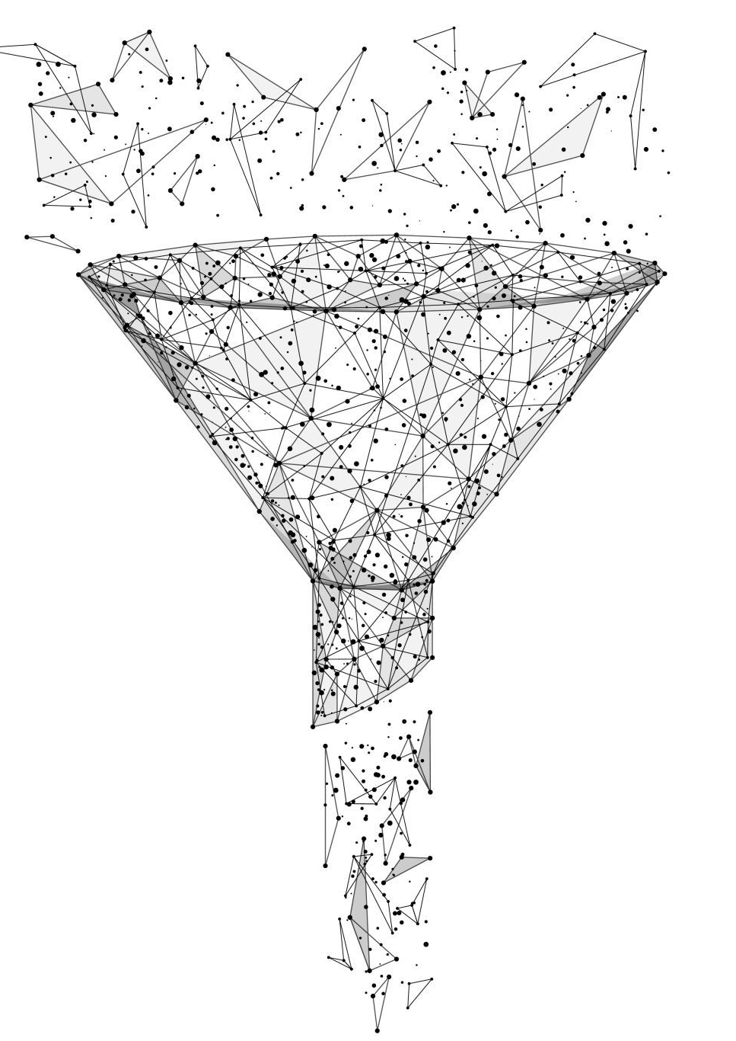
MVP Development

Slide 15
Week 1: Concept and Planning
We defined the MVP objectives and scope which include the key features
We Identified target user groups and their needs with the use of a questionnaire which lead to building a web application based on the results we analyzed
We establised a project plan and timeline

Slide 16

Week 2: Design and Prototyping
Development processes for the TheraBalms interface began
Created a user-friendly interface
Prototype key features, including self-assessment, consultation, psycho-education, and progress tracking

Slide 17
Week 3: Development
Started to build the MVP platform based on approved designs
Focus on core features: self-assessment, consultation/counseling, psycho-education, and progress tracking

Slide 18
Week 4: Testing and User Feedback
The entire team conducted testing to identify and resolve initial bugs or issues
Also, we gather insights from early users to make refinements and improvements

Slide 19
Major Milestones
Development and Testing of Core Features
Launch of MVP for User Testing and Feedback

Slide 20
Team and Resources
1. Responsibilities: Product managers were responsible for defining the MVP's vision, objectives, and scope
Resources: They were able to coordinate with other teams, gather user feedback, and make decisions regarding feature development
Members: Ogaga Obisesan & Toyosi Oyetoke
2. Responsibilities: The data team played a crucial role in implementing data-driven insights and analytics within TheraBalms
Resources: They required data analytics tools, databases, and expertise in data analysis
Members: Ese Amadasun, David Sado & Temitope Amos
3. Responsibilities: This team were responsible for creating and curating content for TheraBalms, including articles, blog posts, and educational materials

Slide 21
Team and Resources
Resources: Content creation tools, marketing resources, and expertise in content development and promotion
Members: Damilola Ajeigbe & Zainab Yekini
4. Responsibilities: The engineering team were tasked with the technical development of the MVP platform
Resources: Technical expertise, software development tools, and infrastructure for building and deploying the platform
Members: Isheyemi Oluwagbenro, Oreoluwa Olufemi, Godswill Umoh, Jerry Aluko & Chukwuemeka Grace

Slide 22

Business Model
Subscription-Based Model:
In this model, users will be paying a recurring fee to access the full range of TheraBalms' services.
Subscribers will benefit from uninterrupted access to consultations, self-assessment tools, psycho-education resources, and progress tracking.
This model ensures a steady stream of revenue and encourages user engagement and loyalty.

Slide 23

Challenges and Risks:
1. Insufficient time
2. Epileptic power supply
3. Restricted platform for group communication
4. Limited data responses

Slide 24
Conclusion:
In summary, TheraBalms is a groundbreaking initiative aimed at revolutionizing the therapy sector to address several pressing challenges.
The therapy industry faces hurdles related to accessibility, stigma, affordability, and data security.
TheraBalms introduces its MVP (Minimum Viable Product), a vital stepping stone towards creating a comprehensive mental wellness platform that caters to individual needs and promotes inclusivity.

